Slide 1

Uni-in Multi –out gate
Presented by
Dhenishaa V N
Register No: 22EC031
DEPARTMENT OF ECE
CHENNAI INSTITUTE OF TECHNOLOGY(An Autonomous Institution)

Slide 2
Problem Statement/Definition
Building Logic Gates using transistors which is useful for digital circuits
My aim is to minimize the size of digital circuits which are generally using all logic gates. By using Universal gates such as NOR & NAND gates, I try to minimize the size and number of components used for the digital circuits.

Slide 3
Proposed Solution
Outline your solution: Outline your solution or approach to the problem. Use bullet points or a flowchart to break down the steps or stages of your project..

Slide 4
Hardware Requirements
BC547 Transistors
Resistor – 10K and 220 ohm
LED Lights
Bread Board
9 Volt Battery
Connecting Wires
Switches

Slide 5
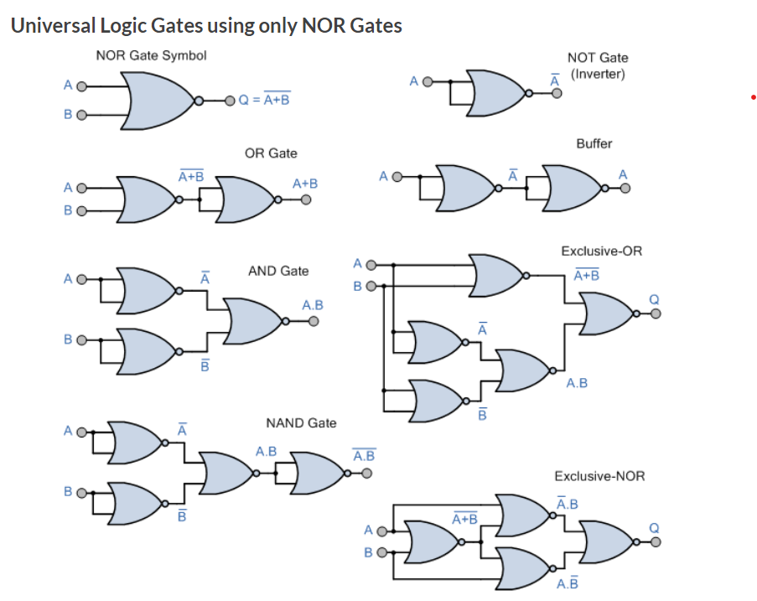
Block Diagram

Slide 6
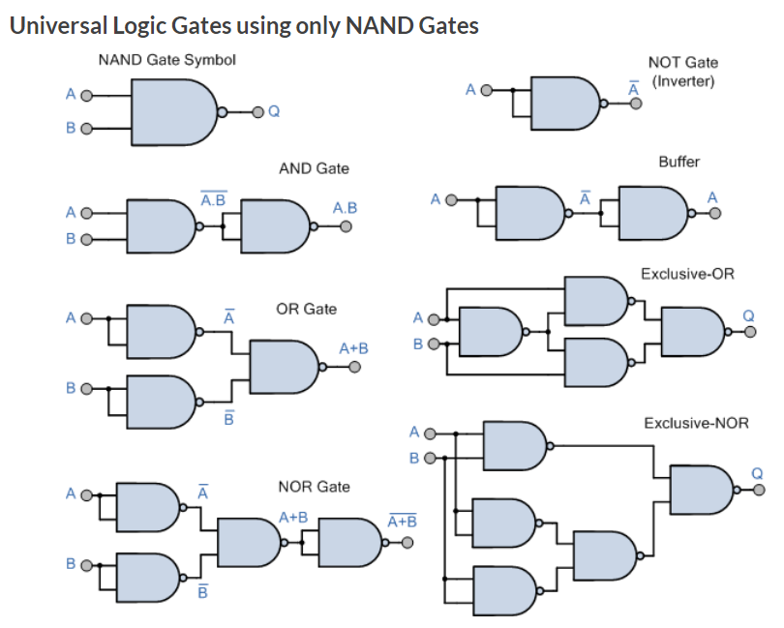
Block Diagram

Slide 7
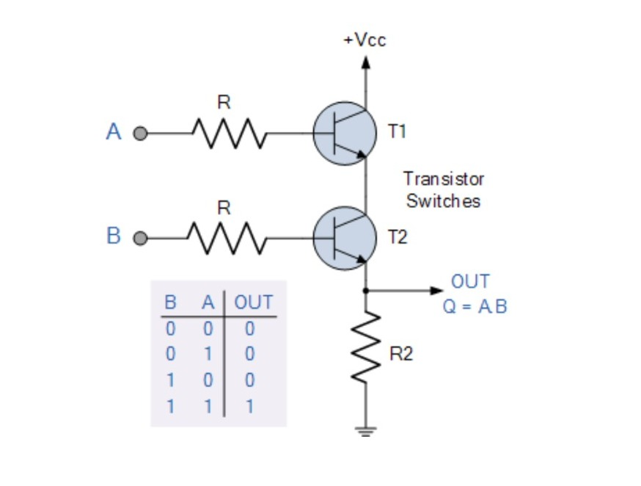
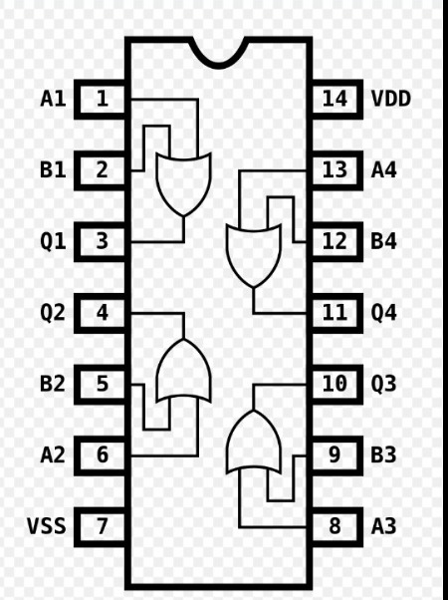
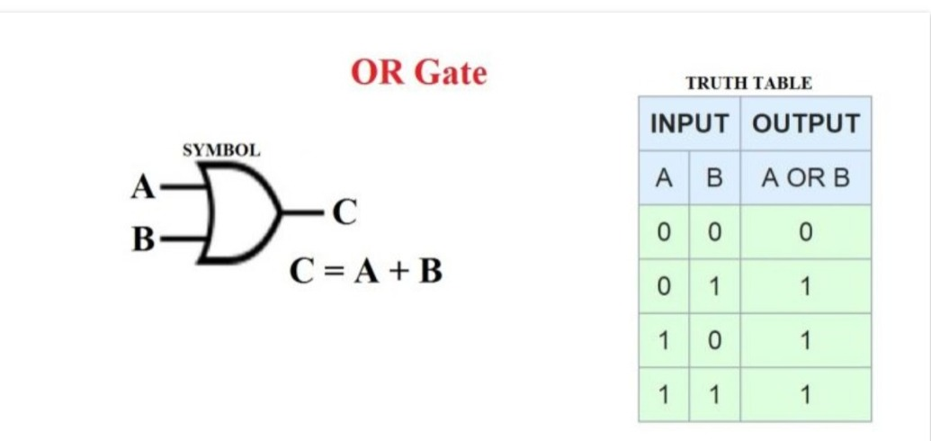
Circuit Diagram/Flowchart
The OR gate is a digital logic gate that implements logical disjunction.
The OR gate returns true if any one of its inputs are true; otherwise it returns false.
A logical OR operation has a high output (1) if one or both the inputs to the gate are high (1). If neither input is high, a low output (0) results.

Slide 8
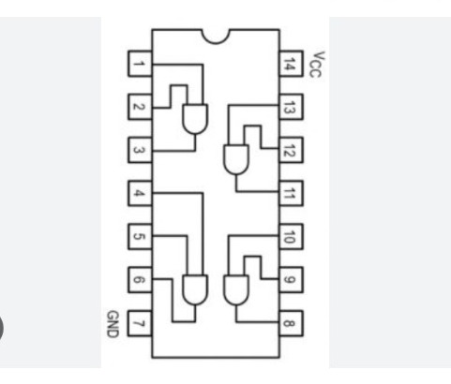
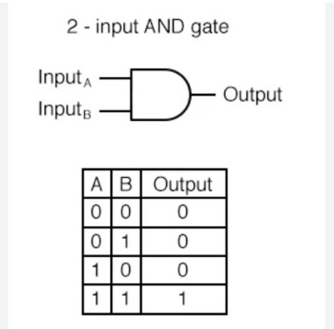
Circuit Diagram/Flowchart
The AND gate is a basic digital logic gate that implements logical conjunction (^) from mathematical logic.
The AND gate behaves according to the truth table. A High output (1) results only if all the inputs to the AND gate are High (1). If not all inputs to the AND gate are High, Low output results.

Slide 9
Output Snapshots

Slide 10
Output Snapshots

Slide 11
Output Snapshots

Slide 12
Future Enhancement
Describe how the system can be upgraded/enhanced in future

Slide 13
References
List out the sources that you have referred for carrying out the project (books, magazine, websites etc)
DEPARTMENT OF ECE
CHENNAI INSTITUTE OF TECHNOLOGY

